Slide 1
The Industrial Military Complex and Stocks
Aahan Kumar

Slide 2
Research Question
“How do different U.S companies and sectors react to the outbreak of conflict?”

Slide 3
Why I found this interesting:
I chose this dataset because global conflict is one of the most powerful and volatile causes of change in financial markets. By tracking a specific group of assets, I can analyze market reactions during times of war. I find this dataset incredibly interesting because it provides a real-time, step-by-step look at how global instability and strategic decisions are reflected in the market.

Slide 4
01
For several wars/conflicts, what was the S&P 500's behaviour throughout the war and after?
Notes:
law

Slide 5
Case Studies
Iraq Invasion
9/11 Attacks
Pearl Harbor
Cuban Missile Crisis
Russia-Ukraine War

Slide 6
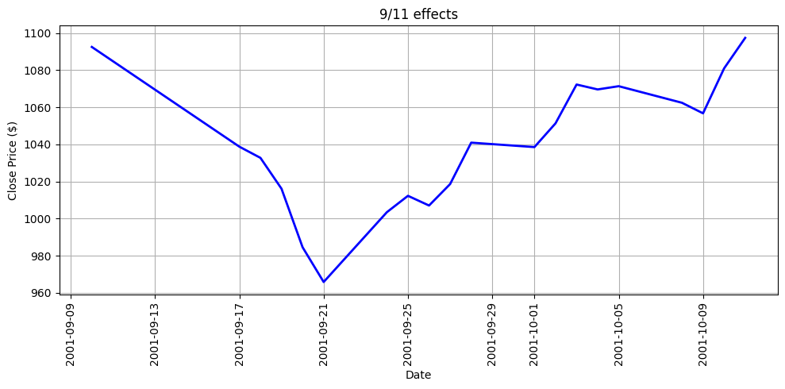
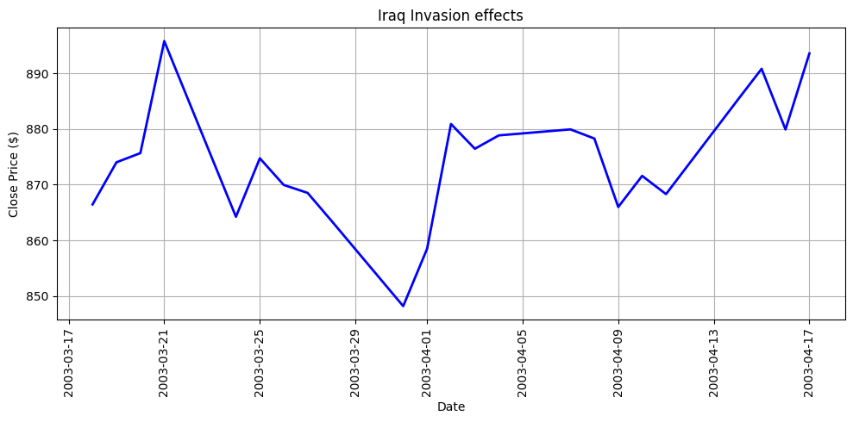
Case Studies 1-2
ONE MONTH MEASURING PERIOD
START DATE:
TREND:

Slide 7
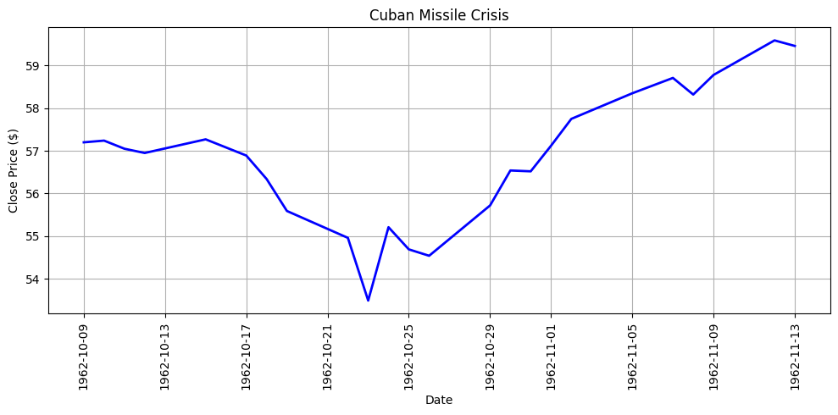
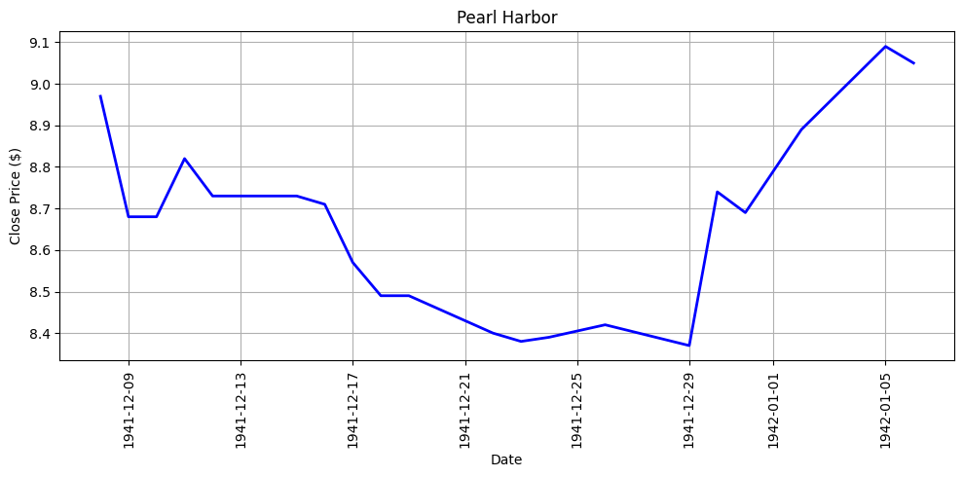
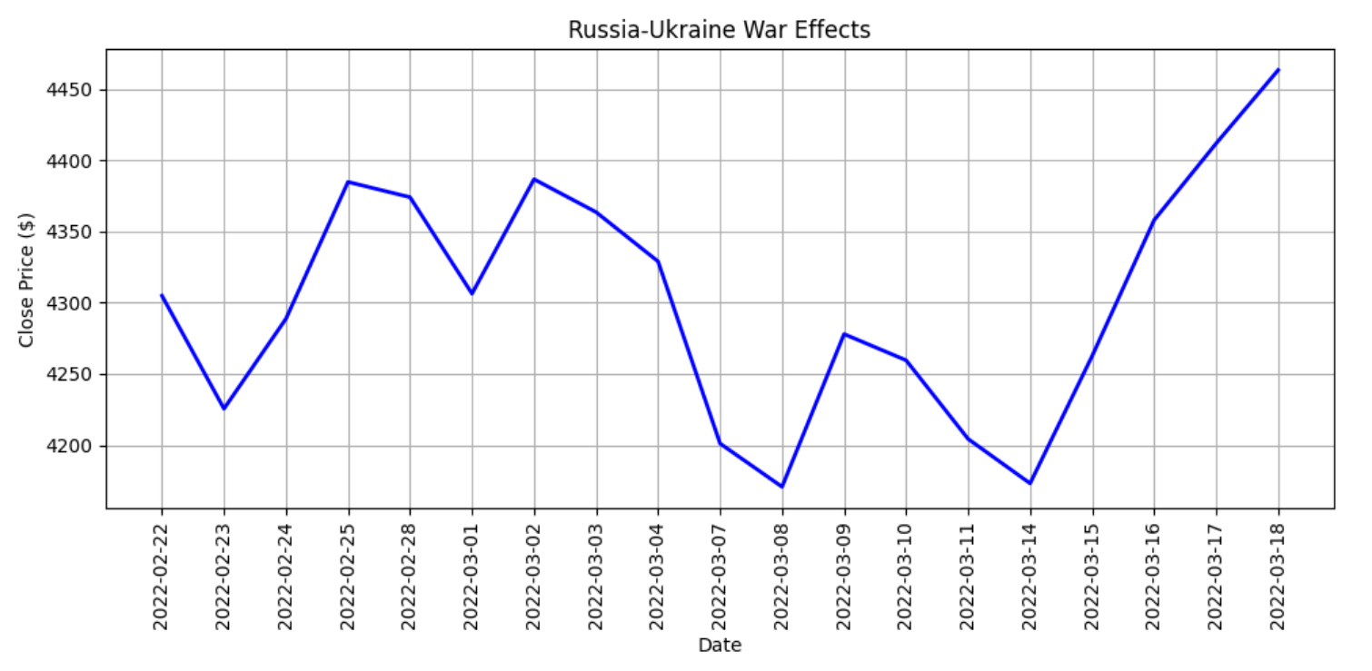
Case Studies 3-5
ONE MONTH MEASURING PERIOD
START DATE:
TREND:

Slide 8
02
Is investing in defense worth it? Which of Lockheed Martin, Raytheon, Northrop Grumman, and General Dynamics has the highest cumulative return since 2000, and have defense companies outperformed the S&P 500?
Notes:
Roger

Slide 9
Return Values
Lockheed Martin
2000/01/03 ~10.34
2026/07/17 ~524.04
4864%
Raytheon
2000/01/03 ~11.28
2026/07/17 ~197.35
1623%
Northrop Grumman
2000/01/03 ~13.87
2026/07/17 ~535.90
3639%
General Dynamics
2000/01/03 ~14.14
2026/07/17 ~375.33
2508%

Slide 10
It’s Worth It!
S&P500
2000/01/03 ~1455.22
2026/07/17 ~7456.60
418%
From a long-term point of view, investing in defense has frequently been more valuable than investing in the S&P 500. However, doing so comes with problems such as higher volatility and risk, government intervention, and ethical problems.

Slide 11
03
What are oil's 20 largest single day percentage moves, and how many of them coincide with the dates of wars?

Slide 12
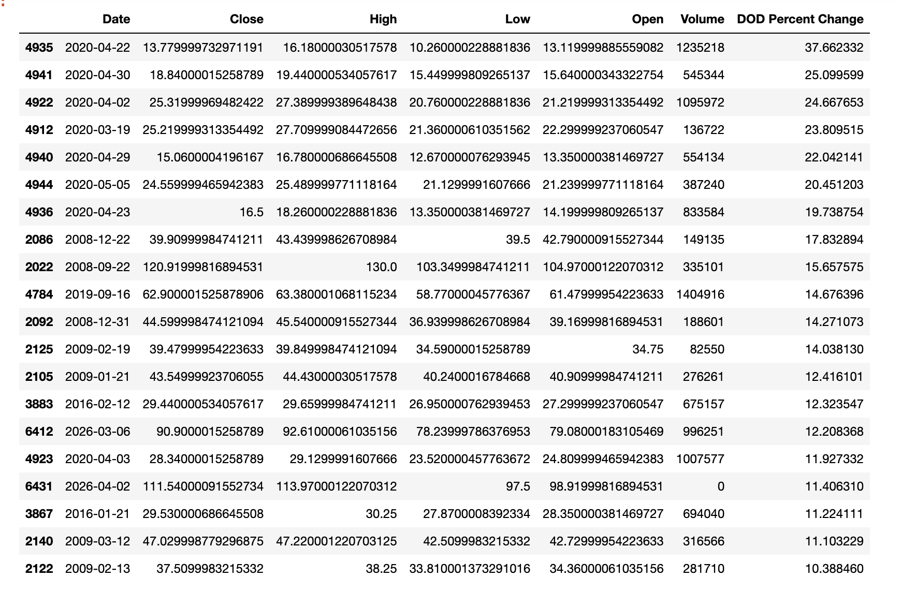
OILS TOP 20 PERCENT MOVES
Top 20 % moves
37.66%
25.10%
24.67%
23.81%
22.04%
20.45%
19.74%
17.83%
15.66%
14.68%
14.27%
14.04%
12.42%
12.32%
12.21%
11.93%
11.41%
11.22%
11.10%
10.39%
*Percents Rounded to 100th place

Slide 13
Findings
12
OUT OF 20 MOVES
60% Correlation
The Majority of oil’s most violent price swings are directly triggered by economic warfare, proving war is the primary driver of extreme market volatility. Some main drivers were the 2008 Gaza war, the 2026 U.S-Iran escalation, and the 2020 Saudi-Russia price war.

Slide 14
04
What were the S&P 500's five best and five worst single days in the sample, and how many of them are near the end or beginning of a conflict?

Slide 15
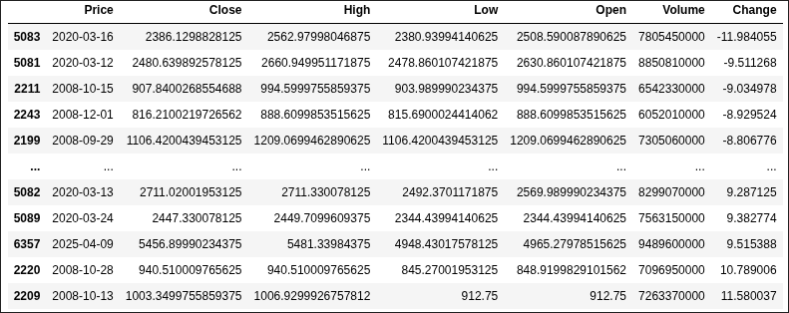
Q4 Analysis
2008 Dates - Global Financial Crisis
2020 Dates - COVID 19 Crash
2025/04/09 - Trump's announcement of a 90-day pause on tariffs

Slide 16
What This Means
None of the S&P 500’s top 5 best or worst days were caused by wars or conflicts. They were caused by financial disasters and economic shocks.
This emphasizes the geographical bounds of wars and how their influence targets specific sections of the economy (such as oil, defense stocks).

Slide 17
05
How correlated are the gold, oil, and defense industry stocks during times of war and unrest?
Notes:
Rahul

Slide 18
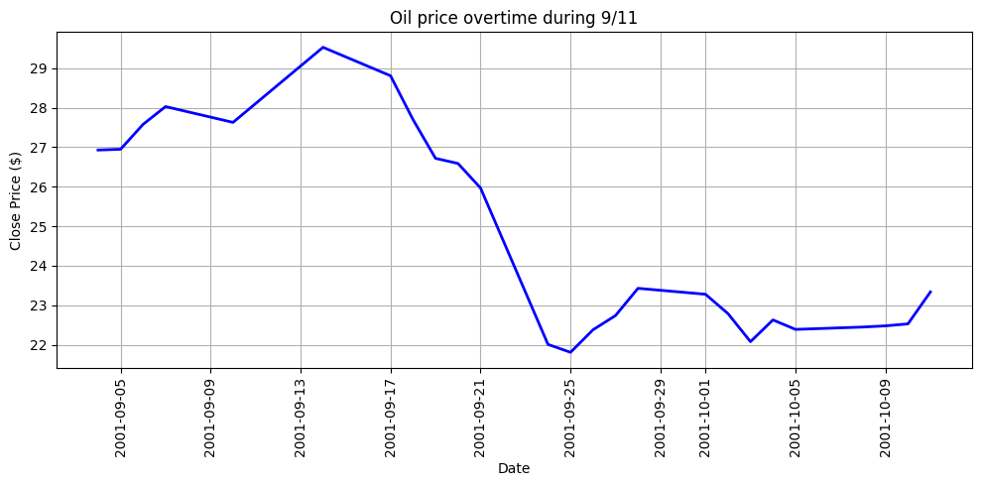
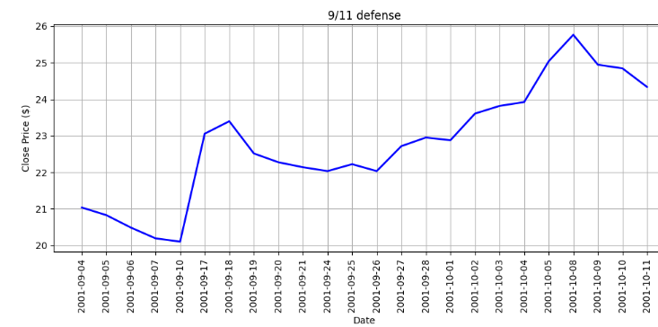
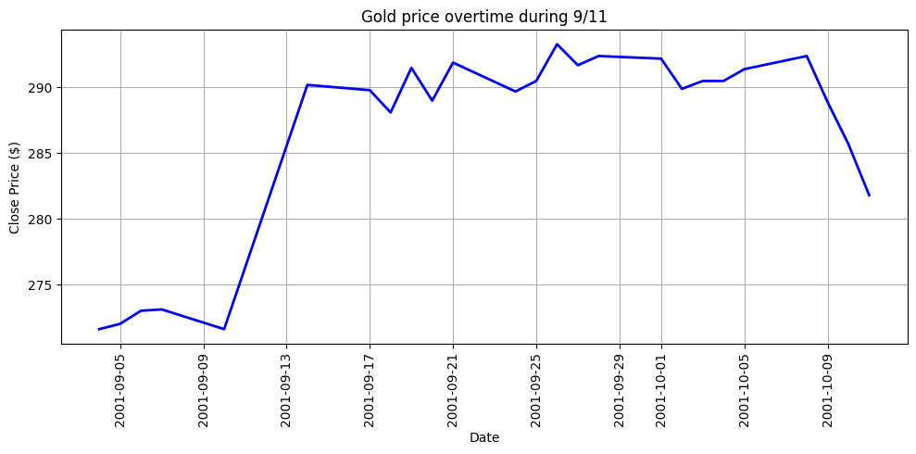
Case 1: 9/11
Oil prices overtime
START DATE:
TREND:

Slide 19
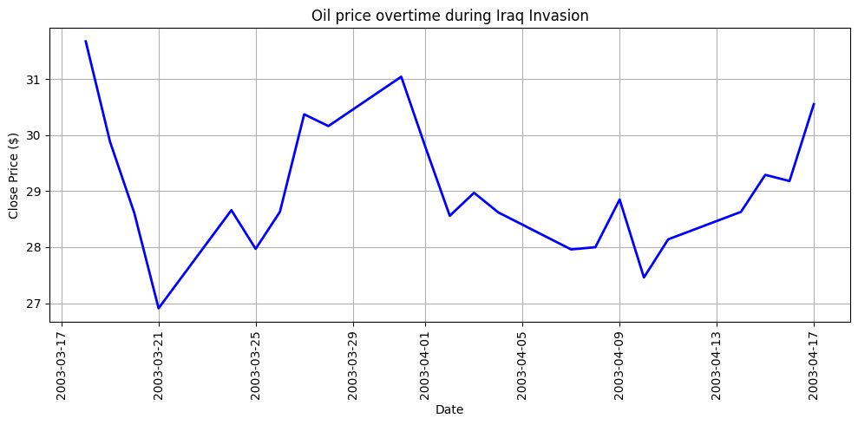
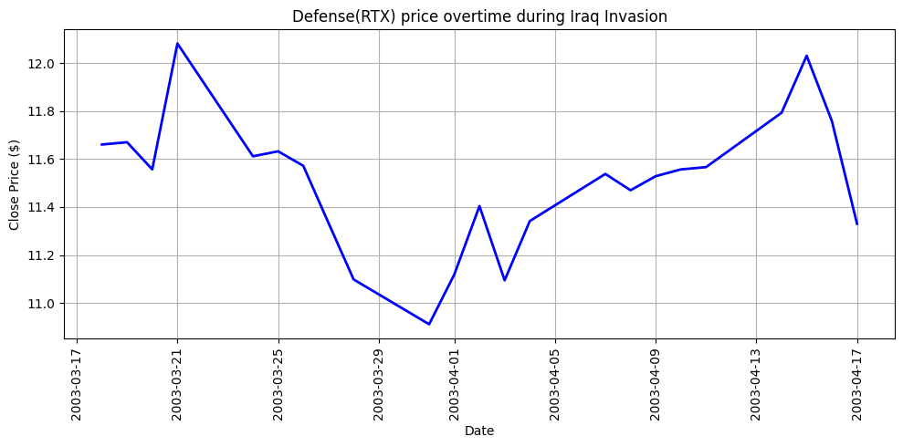
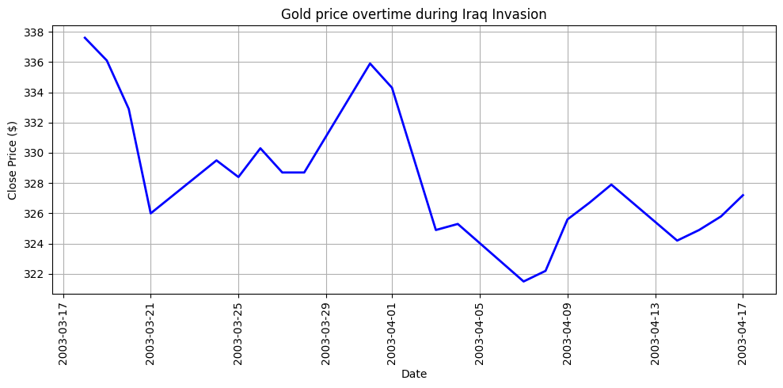
Case 2: Iraq Invasion
Oil Prices Over Time
Defense Prices Over Time
Gold Prices Over Time
START DATE:
TREND:

Slide 20
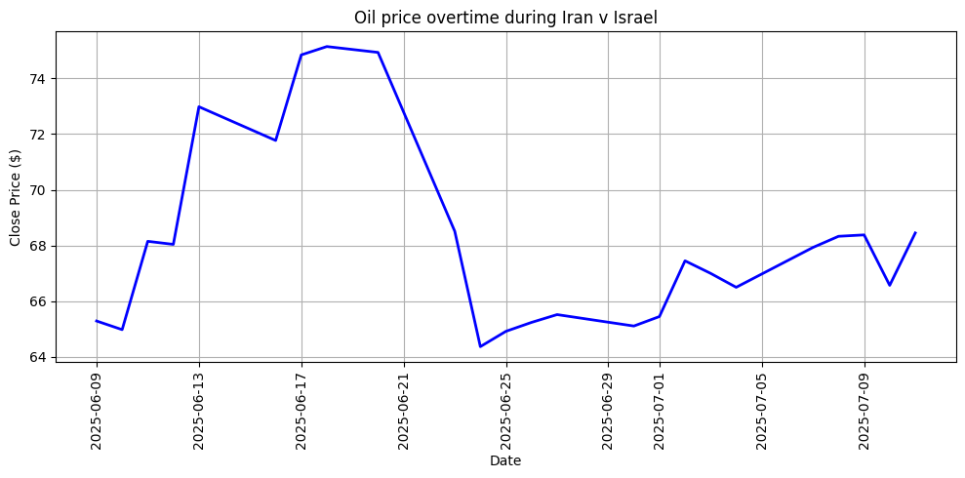
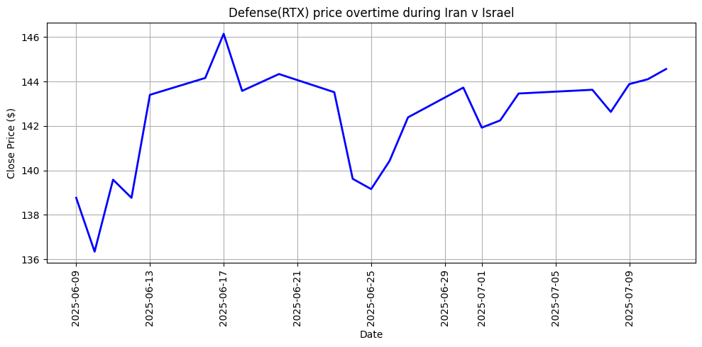
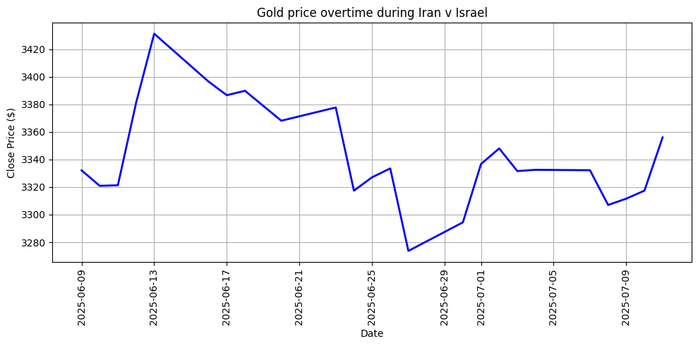
Case 3: 12 day war
Oil Prices Over Time
Defense Prices Over Time
Gold Prices Over Time
START DATE:
TREND:

Slide 21
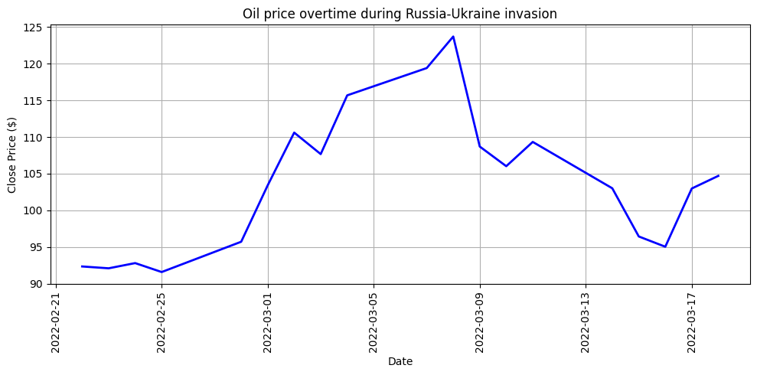
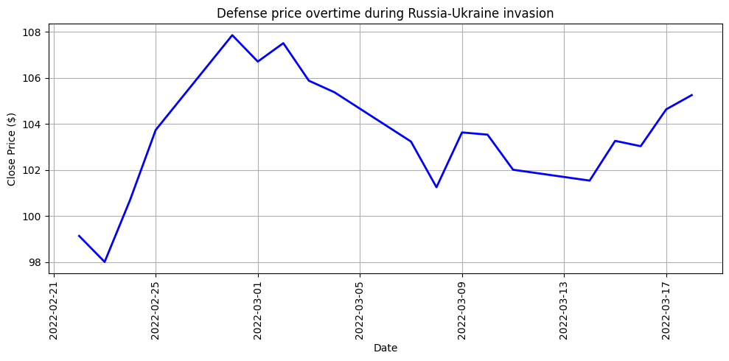
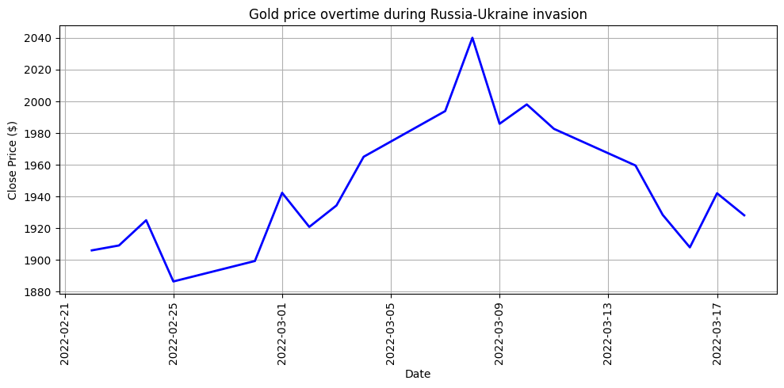
Case 4: Russia-Ukraine War
Oil Prices Over Time
Defense Prices Over Time
Gold Prices Over Time
START DATE:
TREND:

Slide 22
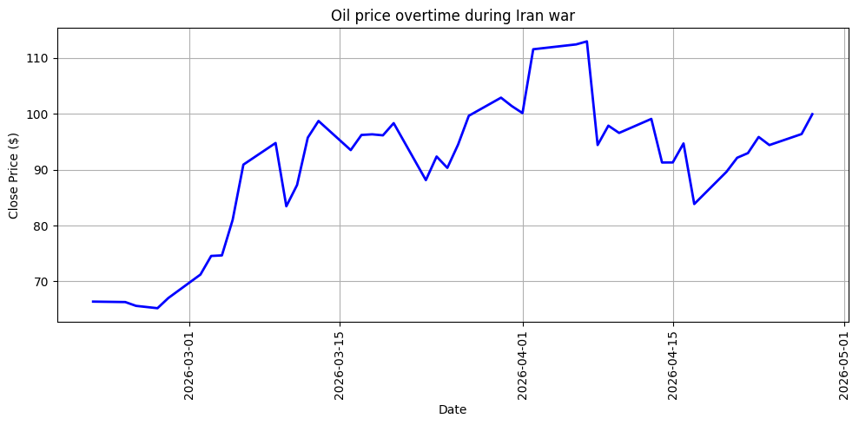
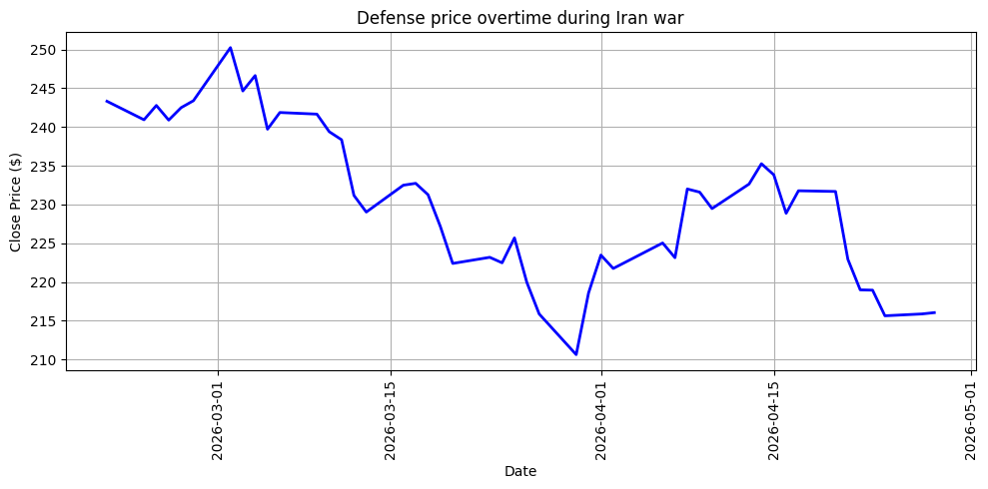
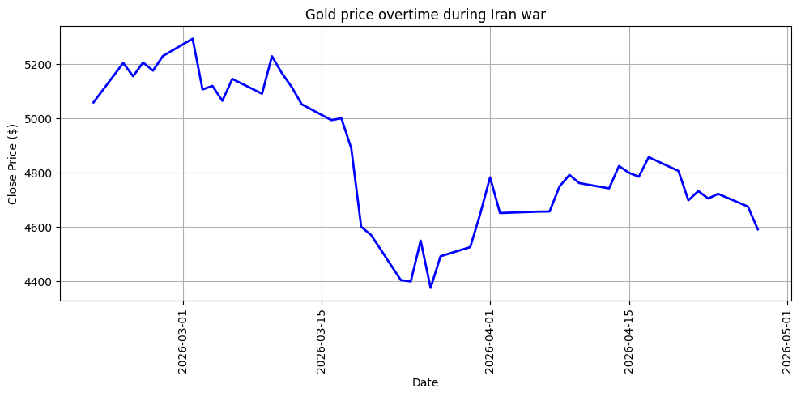
Case 5: Iran War
Oil Prices Over Time
Defense Prices Over Time
Gold Prices Over Time
START DATE:
TREND:

Slide 23
06
Which sectors have winning and losing tendencies during war? (energy, defense, airlines, and the broad index)

Slide 24
Case Studies
Energy : Exxon Mobil
Defense : RTX Corporation
Airlines : Delta Air Lines
Broad Market : S&P500
Strait of Hormuz :

Slide 25
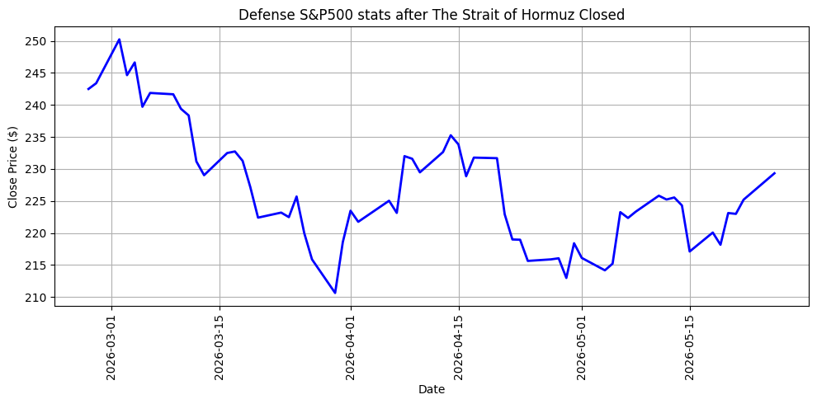
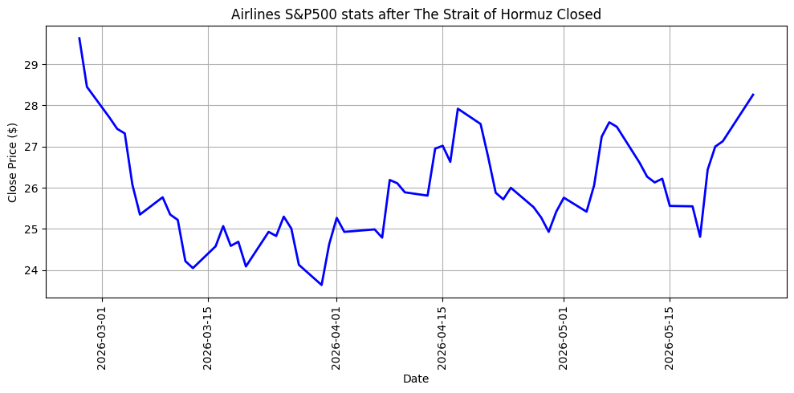
Airlines & Defense
TWO MONTH MEASURING PERIOD
START DATE:
TREND:
Defense S&P500 Stats
Airlines S&P500 Stats

Slide 26
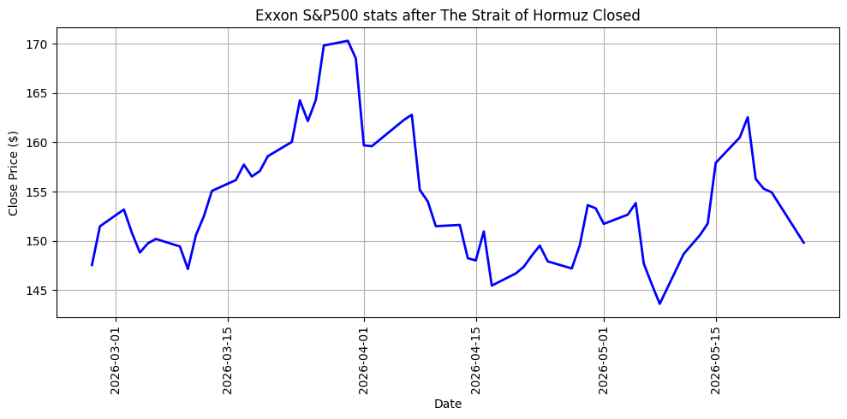
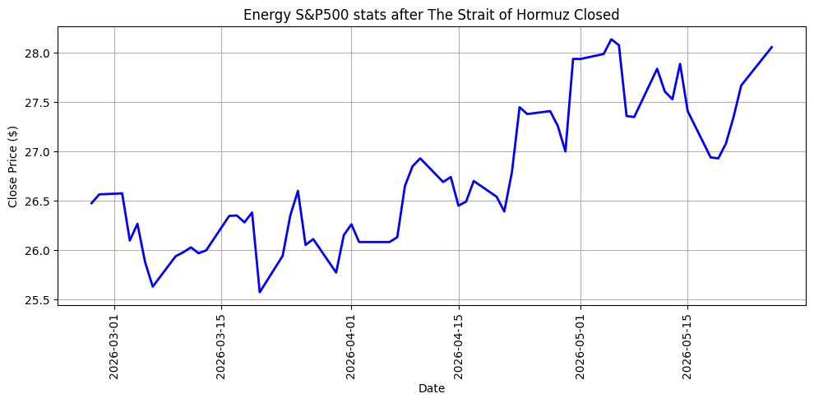
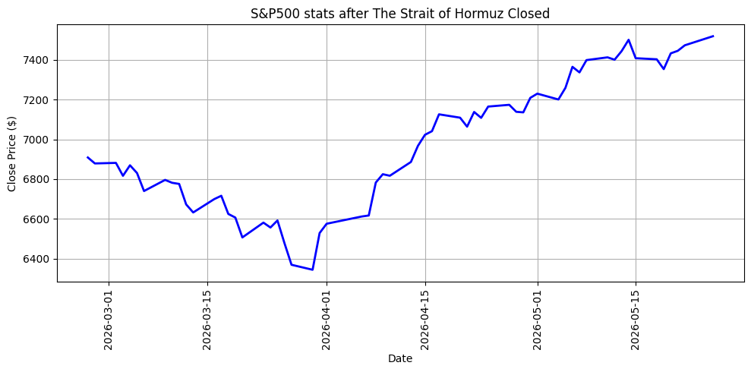
Energy & Broad Market
TWO MONTH MEASURING PERIOD
START DATE:
TREND:
Exxon S&P500 Stats
Energy S&P500 Stats
S&P500 Stats

Slide 27
07
Do defense stocks rise during or after war? Look at the defense sector’s return and behavior relative to the S&P 500 from 2 months before each onset trading day to 2 months after?

Slide 28
RUSSIA-UKRAINE INVASION
S&P 500
DEFENSE
Ukraine-Russia invasion S&P 500 industries before: -10.586378889607785%
Ukraine-Russia invasion S&P 500 industries after: 0.17301097155520195%
Ukraine-Russia invasion defense industries before: 6.48526262642843%
Ukraine-Russia invasion defense industries after: 11.574138052019581%

Slide 29
Thanks!

